Slide 1
Practical Activity – Area
Miss Lum
Year 11 Essentials

Slide 2
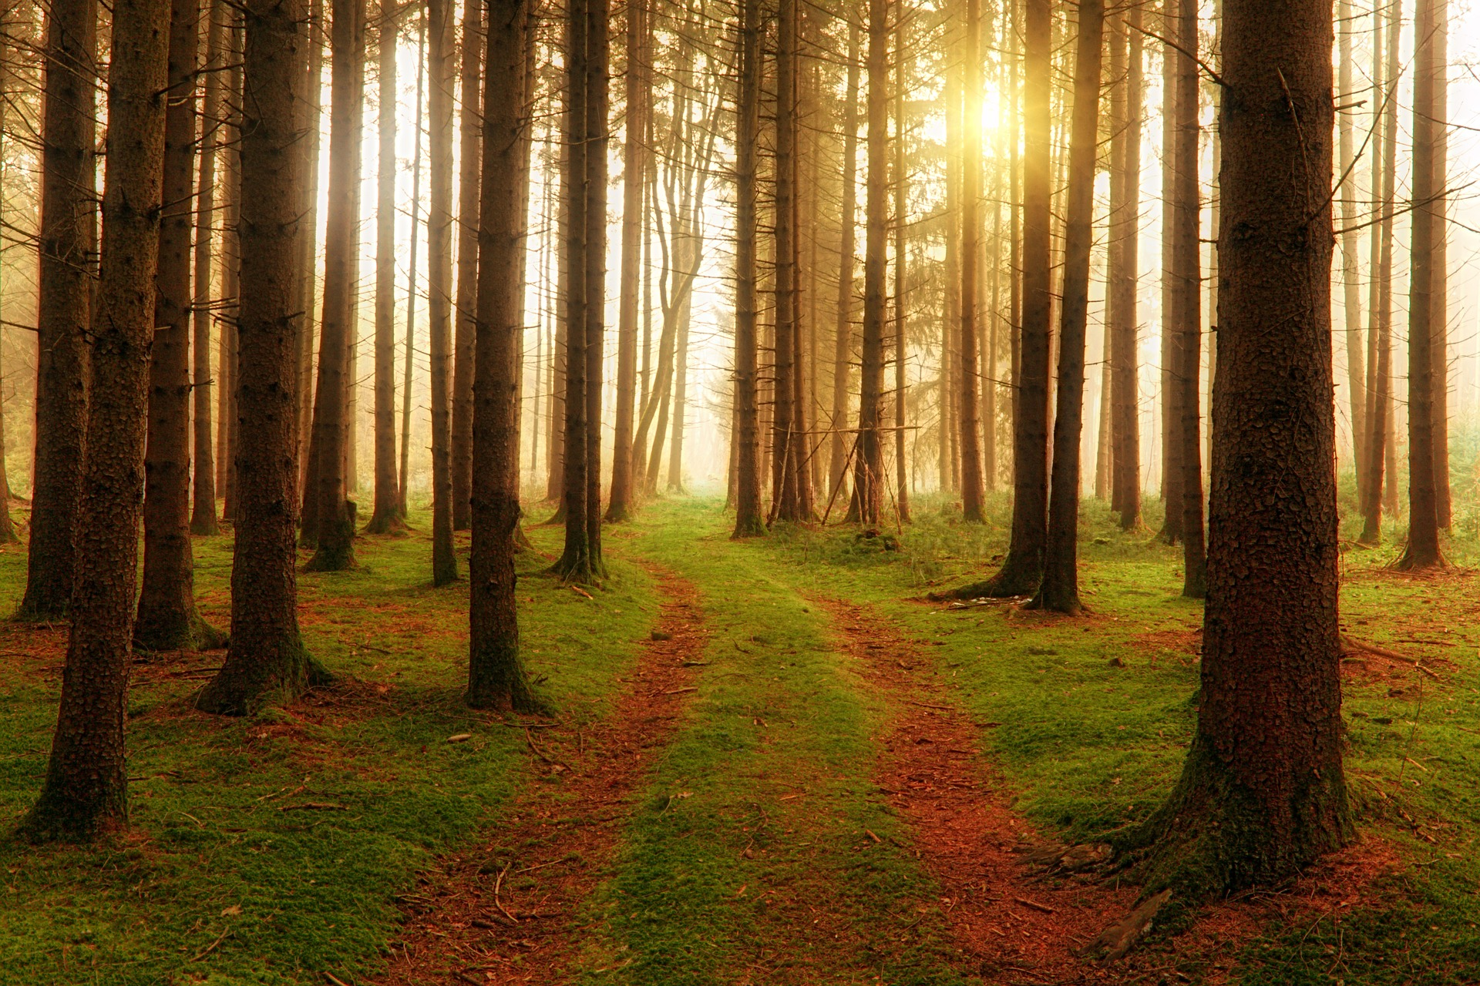
Learning Outcomes
1.3.5 Choose and use appropriate metric units of area, their abbreviations and conversions between them
1.3.6 Estimate the areas of different shapes
1.3.7 Convert between units of area and other area units
1.3.8 Calculate areas of rectangles, triangles, and composite shapes
Practice the Mathematical Thinking Process

Slide 3
24
7
30
Mathematical Thinking Process
Date: /03/2018
EQ – What is the Mathematical Thinking Process?
Interpret the task and gather the key information
Identify the mathematics which could help to complete the task
Analyse information and data from a variety of sources apply their existing mathematical knowledge and strategies to obtain a solution
Verify the reasonableness of the solution
Communicate findings in a systematic and concise manner.
Notes:
Discuss with students the strategies of how to complete each task and what would be expected.
CUBE strategy for maths
Circle key numbers
Underline the question
Box any math action words. Write operation sign if possible
Eliminate any unnecessary information
Solve and check answer
Communication of findings must be done in Standard Australian English with full sentences when required. Units of measurement must be included.
A-grade level: Consideration of real world practicalities in the answer must also be demonstrated, (included in the answer). Every measurement or calculation made has meaning.

Slide 4
Task
Until very recently, recyclable waste from around the world was shipped to China. This has no longer been the case since the 1st of January, 2018 as China has placed a ban on importing recyclable waste from other nations including Australia.
We are now facing a crisis with landfill.
Your job is to undertake a study of food packaging to understand how much material is used. You will need to examine an example of food packaging and calculate the total area of material used.

Slide 5
Task
Once you have the measurements and area of the food packaging consider the following:
Do your calculations reflect all of the material used in the packaging?
Recommend how less material could be used in the packaging
What else can be done to reduce the amount of landfill in Australia?
Present your findings and recommendations in a short report, (3 paragraphs), using your calculations to support your argument.

